Slide 1


an ITU Telecom event
6-9 September 2020 in Ha Noi, Viet Nam
ITU DIGITAL WORLD 2020
The global tech event for government, industry and SMEs.
JOIN
[COUNTRY NAME] NATIONAL PAVILION
organized by [Organization Name]

Slide 2
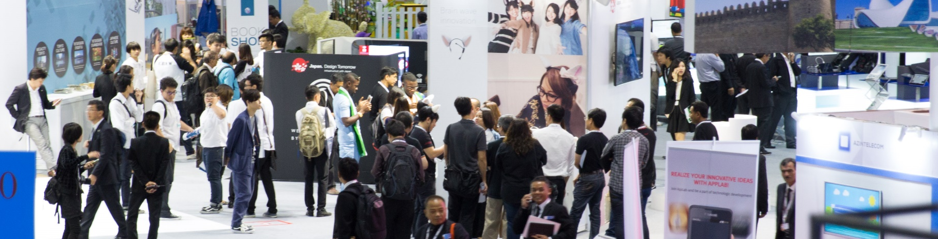

ITU Digital World event is the leading UN global ICT platform connecting tech SMEs, industry leaders, governments, investors, international organizations, consultants and top media from developed and emerging markets for 4 days of:
Showcasing innovative, life-enhancing solutions in the exhibition in areas such as AI, AR, VR, IoT, and robotics, and across UNSDG verticals covering smart cities, cybersecurity, fintech, e-governance, e-agriculture, e-waste management, e-health, e-education, climate change mitigation and more
Knowledge-sharing, collaboration and engagement on the major challenges facing the sector in interactive forum debates
Networking with peers and with leading representatives of government and industry through events, activities, the event app and professional Business Matchmaking Service
Gaining UN visibility from our acclaimed Awards Programme recognizing ICT innovations with a social impact.

Slide 3

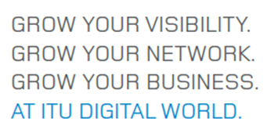
Unique features
Supporting tech SMEs in the development of local innovation ecosystems for local content and services is a key aim of the event. Click below for examples of how past event editions have been very well received by tech SMEs:
Success Stories
SMEs in action video
SME Awards Programme
Photo gallery of SMEs in action
Influential Audience
Best Support
Goal
Best Support
To accelerate ICT innovation for social and economic development, improving lives faster and making the world better, sooner.
High-level audience
(ministers, regulators, C-levels, directors-general, ambassadors…)
Influential audience
(decision & policy makers)
Dominant emerging markets seeking solutions to improve their ICT landscapes
Key stakeholders from across a powerful ICT community
This results in deal-flow, especially for SMEs, business growth/ diversification, and resolving critical industry issues.
Concentrate on the business development and customer relations: we organize your participation
Clear identification through your branded booth
Attractive National Pavilion design creating an inviting atmosphere to drive footfall
Join this important journey - YOU the SMEs are the drivers of accelerating socio-economic development, therefore your success is of great importance.

Slide 4

[Country Name]’s objectives
Through our National Pavilion at ITU Digital World 2020, we aim to enable [Country] tech SMEs to benefit from the strong growth of the promising Vietnamese market:
Provide an opportunity for our nation's tech SMEs to grow their businesses, and for key industry players to diversify at this leading ICT event
Increase the visibility of [national ICT strategy/specific projects, technologies or partnership opportunities]
Meet with potential partners [list any targets]
Network with regional peers, global industry players, leaders of government and industry, tech SME representatives, digital thinkers, media, academia and consultants.
Our Pavilion is organised in conjunction with:
[List of partner organizations/exhibitors/projects]

Slide 5
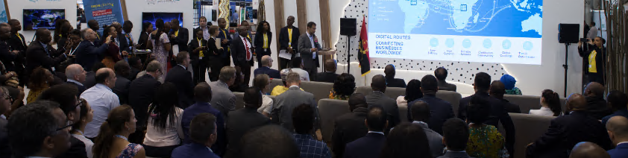
Why join [Country Name]’s pavilion
Exhibiting at World 2020 offers international visibility and an opportunity to take your business to the next level.
Cooperate with local suppliers to enhance competitiveness - over 1,000 m2 of exhibition space will be occupied by local IT companies.
Position your brand, thought-leadership and company as a leader in your field
Showcase innovative technologies, products, services and applications
Develop skills with SME Programme of expert-led capacity building workshops, masterclasses and mentorship
Highlight key projects and investment
Explore partnerships, business deals and high-quality leads
Network through targeted events, activities, business matchmaking service and tools
Announce products, services and partnerships or sign agreements on our international platform
Learn and share knowledge on the latest developments
in the ICT industry
Gain recognition in the ITU Digital Awards Programme, and enable [country name] to enter the Government Award
Enjoy global visibility on the event website, in the event app, in interviews and with guest blogs
Offer Exhibition Passes to your existing and prospective clients
Benefit from targeted support to develop networks and build capacity for key stakeholders

Slide 6
Offer & Timelines
[Insert participation options, what's included, fees & payment terms, and timelines]

Slide 7


Testimonials & SME Success Stories
I am very excited to know a lot of people are recognizing the work we are doing. Here you get to network with people you wouldn’t have back home, some of whom want to work with us when we go back, so we are going to convert all this into business.
Mercy Njue, Botlab, Finalist, ITU Telecom World SME Award Greatest Social Impact
This is extremely good because it allows us now to take our message to a bigger audience, which is the reason we came here in the first place. We have so many discussions, the opportunities we see, taking that message to governments – it is exceptional.
Joel de Messan, CEO, Equanet
The SME Award from ITU Telecom World was a very excellent tool for us to start new business with new companies. Whenever I see Japanese venture companies who have innovative unique technology I tell them you can join ITU Telecom World, it is a good platform and we really appreciate ITU and ITU Telecom World.
Hiroshi Tominaga, General Manager, Japan Battery Regeneration Inc.
Being now in a place where ITU can recognize us for the work we have done, this is just the beginning, this is a long journey but it has started well, thank you! I met wonderful people who understand the problems and really want to make a difference, and it’s overwhelming. Serge Conesa, CEO & Founder, Immersion4, Winner, Global SME Excellence Award
The network and connections you can build at an event like this are invaluable, from a business perspective, from an investor perspective, from a networking perspective. Matthias Brodner, Simplus Innovation, South Africa

Slide 8
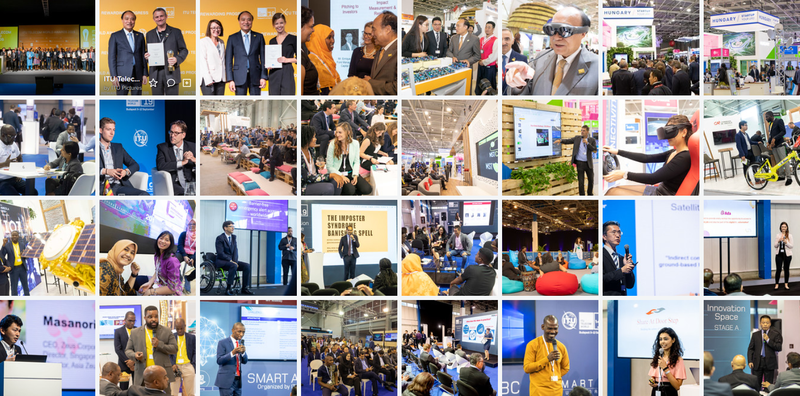
We look forward to seeing you in Ha Noi, Viet Nam,
6-9 September 2020!
[Insert organizer contact details here]
Participating SMEs in action at ITU Telecom World 2019, Budapest

